Slide 1
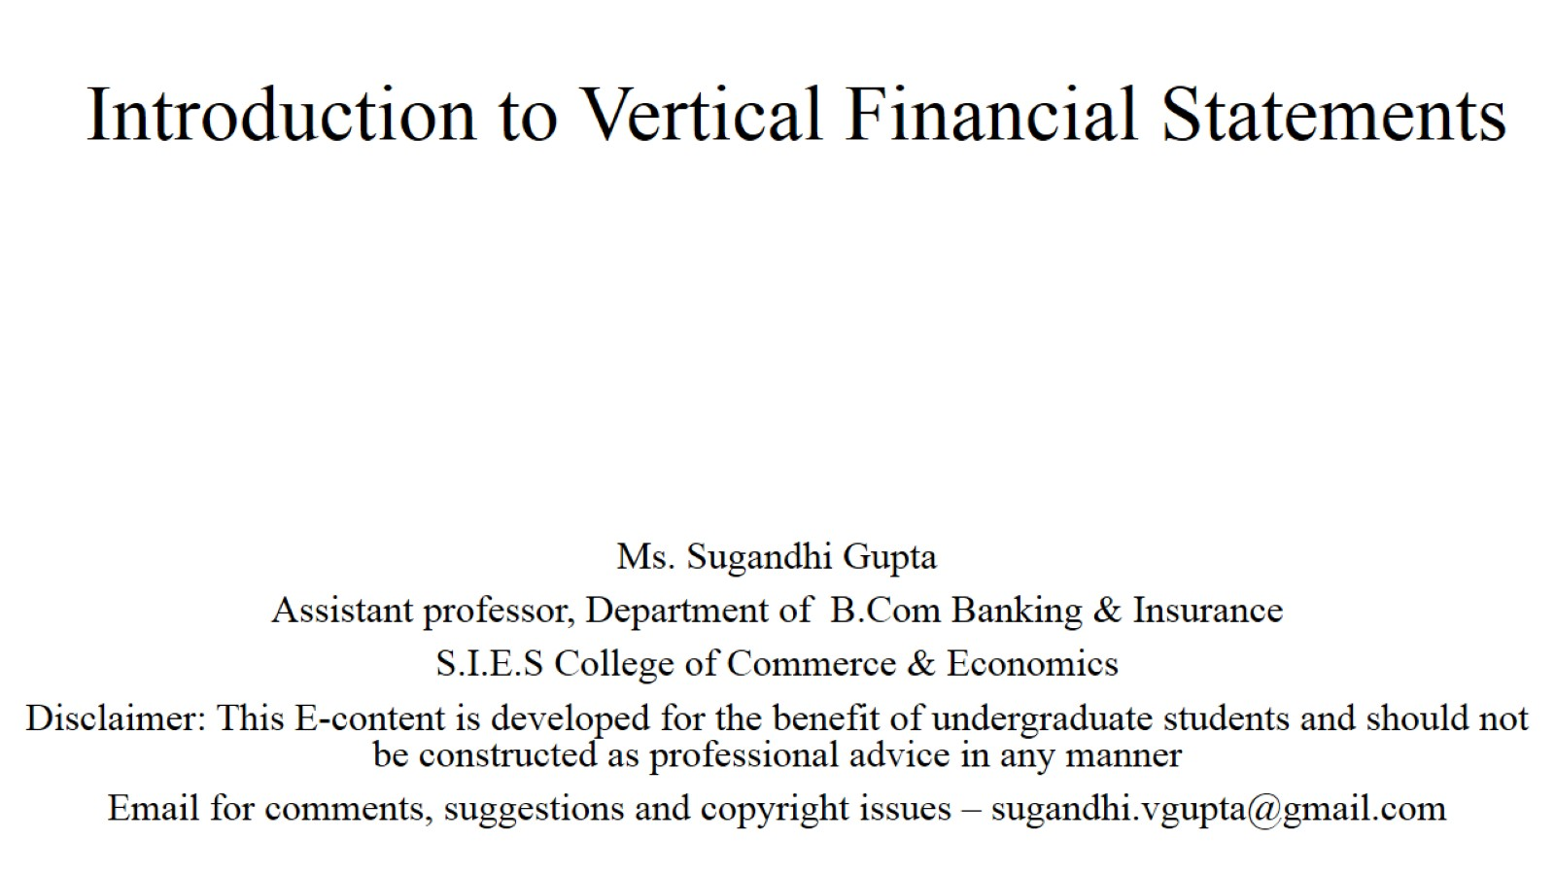
Introduction to Vertical Financial Statements

Slide 2
Users of financial statements

Slide 3
Traditional Balance Sheet

Slide 4
In Vertical Format: Liability Side

Slide 5
In Vertical Format: Asset Side

Slide 6
Vertical Balance sheet

Slide 7
Vertical Balance sheet

Slide 8
Vertical Balance sheet

Slide 9
Traditional Manufacturing , Trading,

Slide 10
Traditional P&L Account

Slide 11
Terms Used

Slide 12
Vertical Revenue Statement

Slide 13
Vertical Revenue Statement

Slide 14
Vertical Revenue Statement

Slide 15
Thank You

